Slide 1
Aquatic Invasive Species Distribution
Geography 1820

Slide 2
Background Information
Aquatic invasive species (AIS) are organisms and plants that have been introduced to new ecosystems and are both harming natural resources and threating human use of resources.
Invasive species are often spread via ballast water of oceangoing and recreational watercraft, intentional and accidental releases from aquaculture, aquarium specimens, bait, etc.
Invasive mussels attach to man made structures causing malfunction and a costly clean-up.

Slide 3
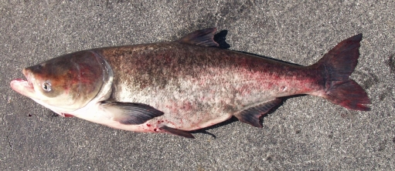
Asian Carp
Asian carp refers to the bighead, silver, grass, and black carp.
Silver and bighead carp are filter-feeding fish and consume plant and animal plankton.
Asian carp can grow to large sizes: some as large as 110 pounds, though the average size is around 30-40 pounds. Bighead and silver carp are voracious eaters, capable of eating 5-20 percent of their body weight each day.
Diet based on plankton which causes disruptions in the food chain.
Negative impact on commercial fishing.
Asian carp become large enough that they have few natural predators.
Escaped from aquaculture to establish wild populations.
DOI. USGS. Southeast Ecological Science Center.

Slide 4
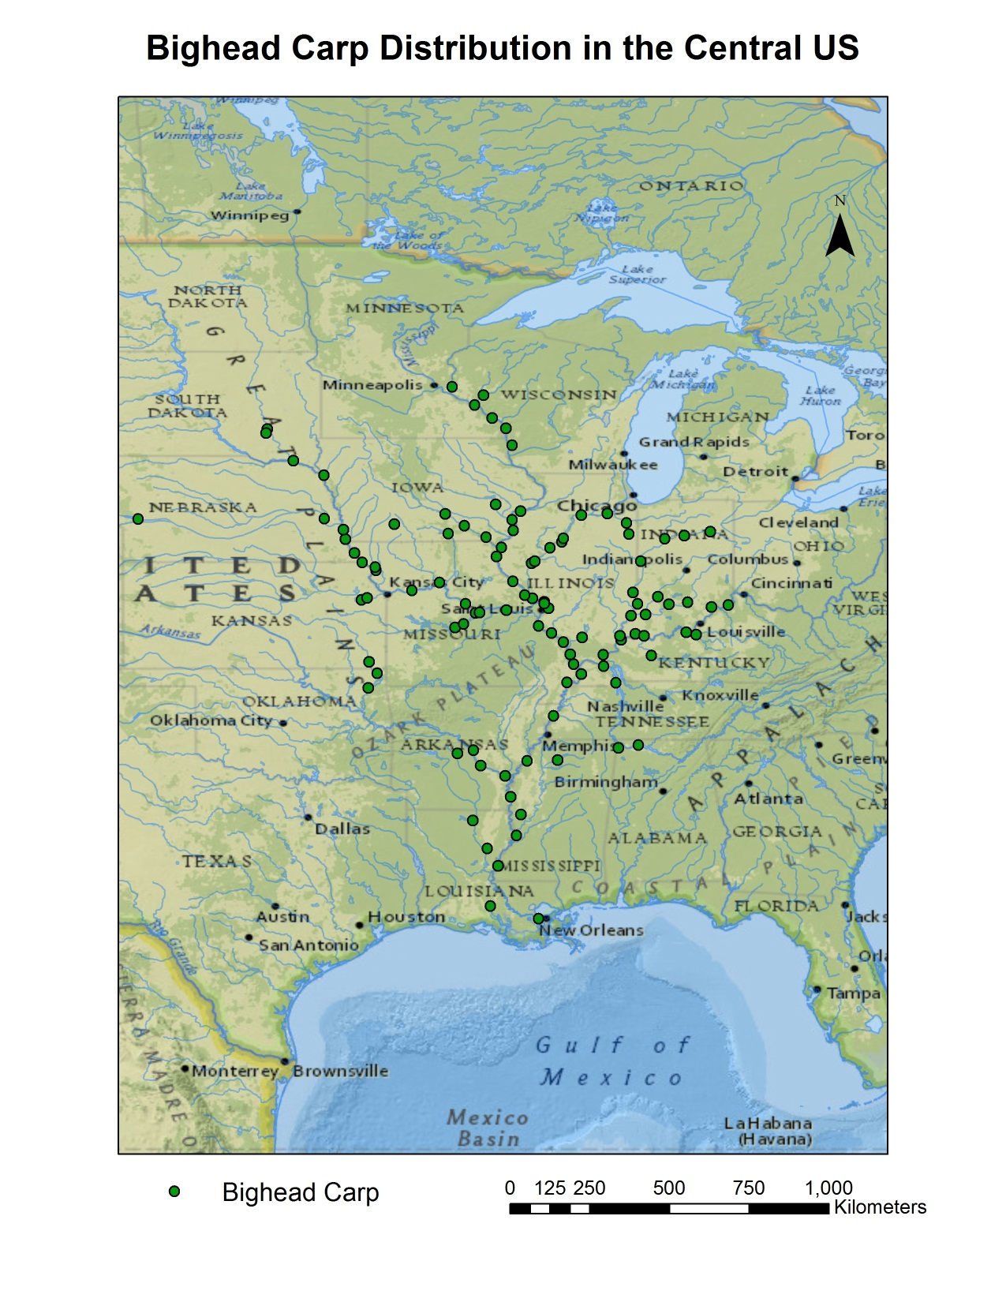
ArcGIS Online
Map Created by: Mike McCarrick
Data retrieved from: Fuller, P. http://nas2.er.usgs.gov/viewer/omap.aspx?SpeciesID=551

Slide 5
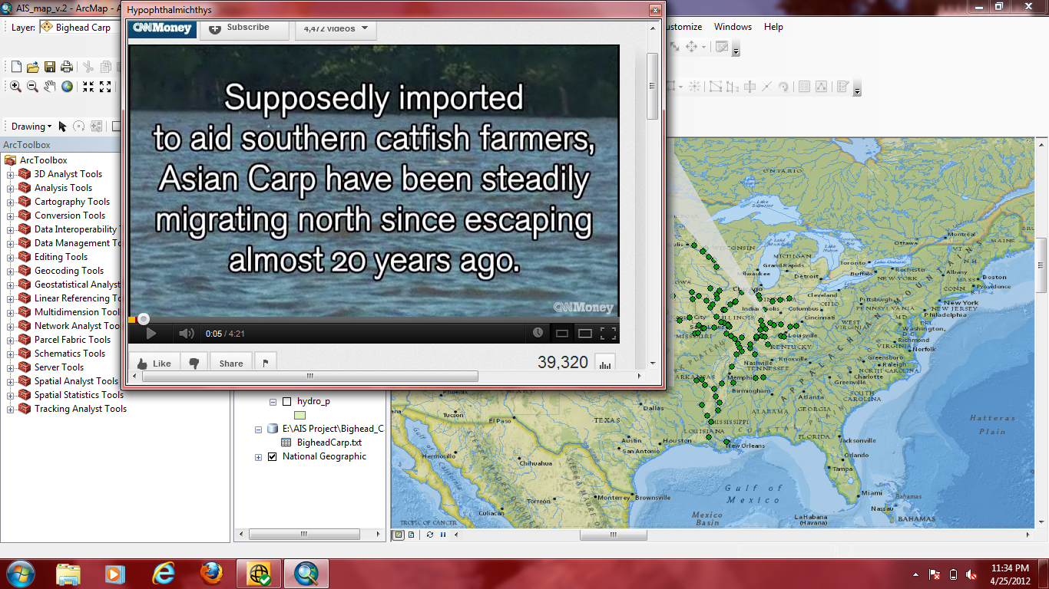

Slide 6
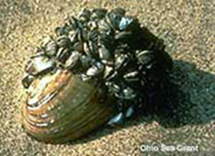
Zebra Mussels
Invasive mussel brought from Eurasia into the Great Lakes region via trans-oceanic ballast water.
Feed on plankton causing disruptions in ecosystem and harm to other organism populations.
Similar in characteristics to Quagga mussels.
Spread throughout the United States by both commercial and recreational boaters.
www.noaagov

Slide 7
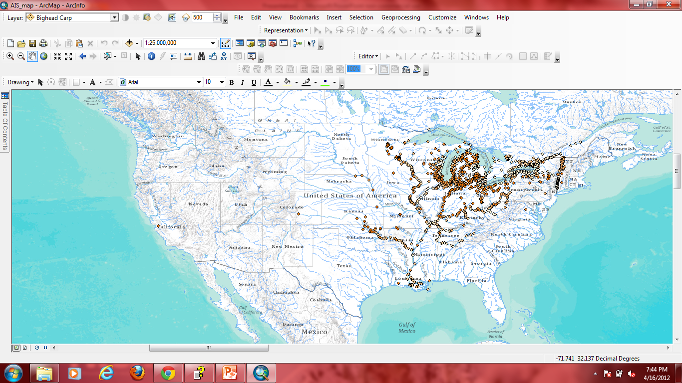
Zebra mussel distribution in United States. Color values show different times of sample collection.
Data retrieved from: US Geological Survey

Slide 8
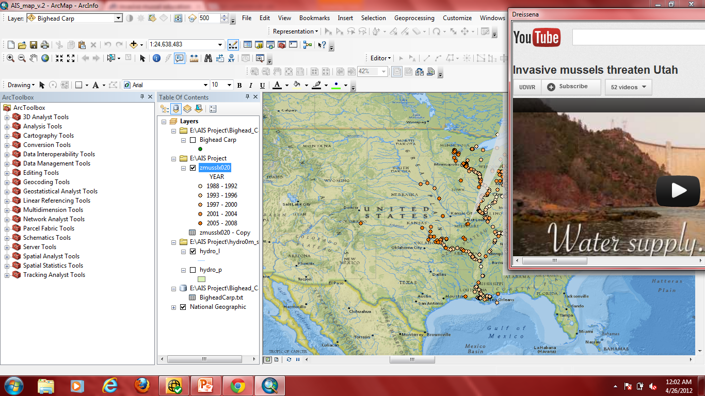

Slide 9
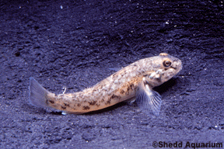
Round Goby
First found in the great lakes region in the mid-1990’s.
Presumably, the goby was released from the ballast water of trans-oceanic ships.
Voracious eaters, their diet in the US consists mostly of zebra mussels and insect larvae.
Unable to establish population in US until the zebra mussel population had developed.

Slide 10
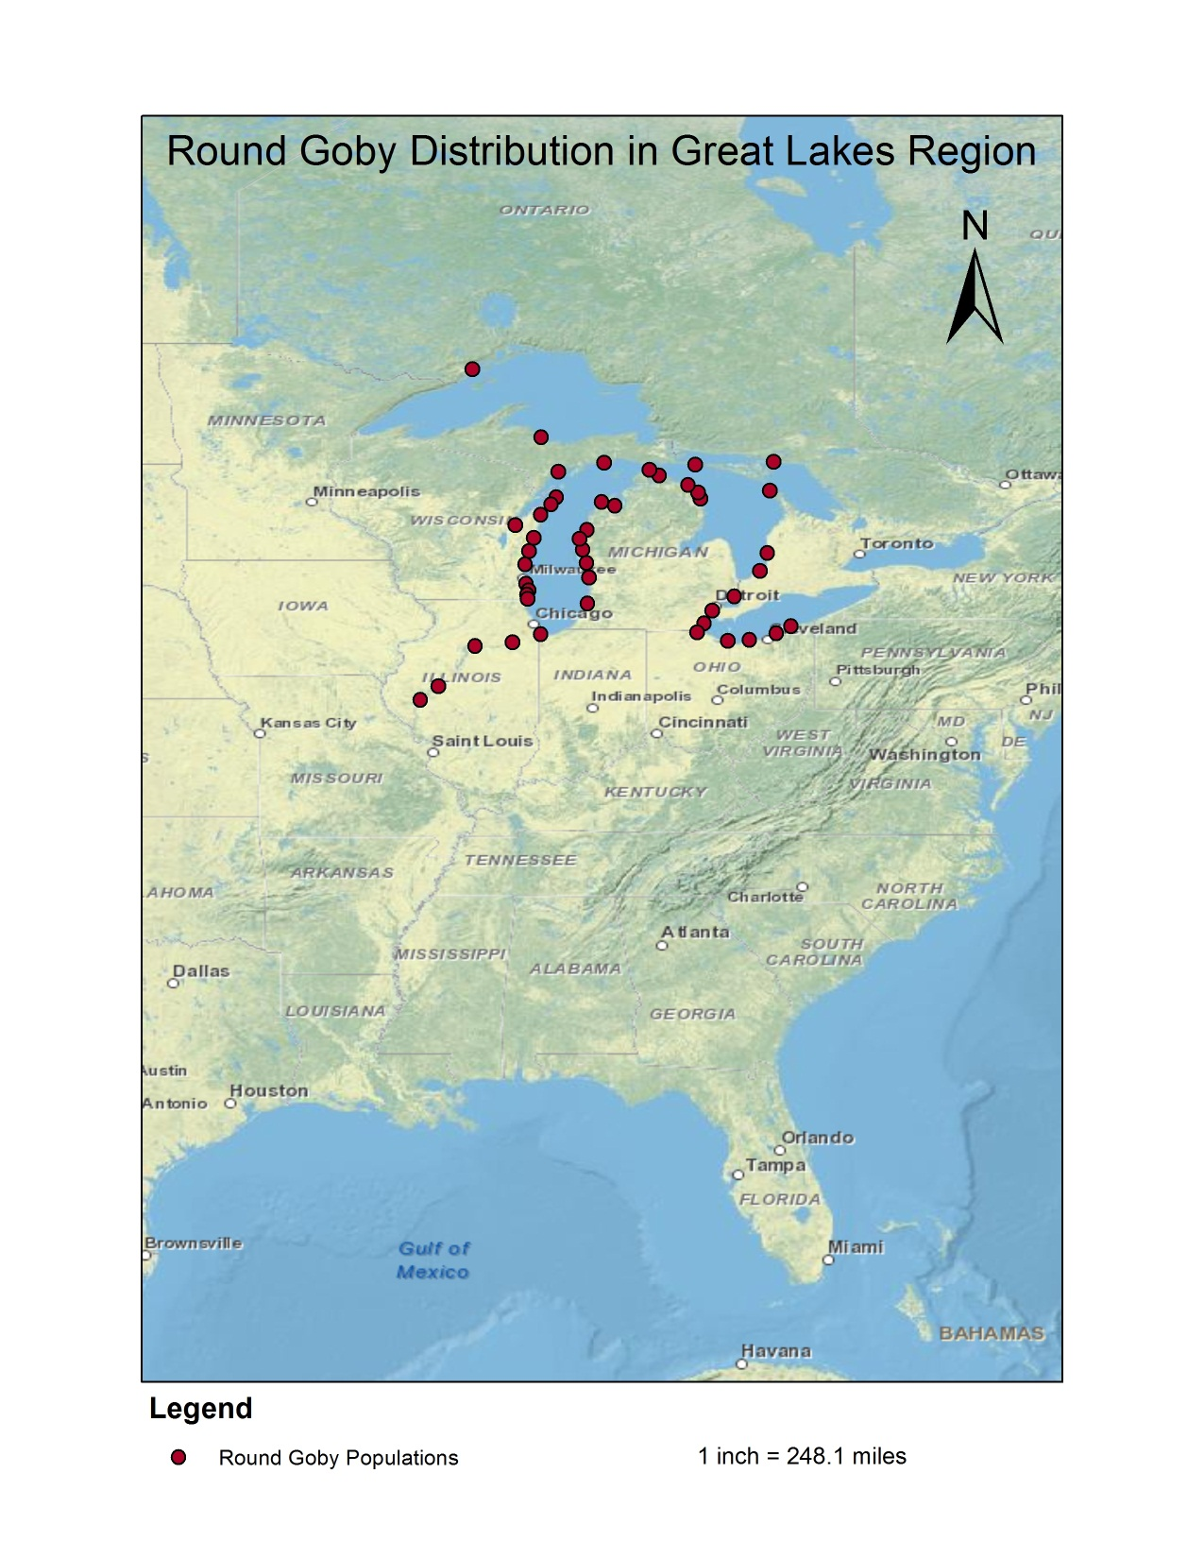
Data Source: Benson, A. J. 2011. Round goby sightings distribution. Retrieved 4/26/2012 from http://nas.er.usgs.gov/taxgroup/fish/roundgobydistribution.aspx.

Slide 11
AIS in Utah
Compared to most areas in the US, AIS have had a relatively low impact on Utah
Geography has probably helped Utah in this regard
Utah does have known populations of several invasive species
State of Utah has intensive programs for preventing the spread of AIS
http://wildlife.utah.gov/dwr/invasive-mussels.html
Positive test for quagga mussel larvae in Red Fleet Reservoir (just N of Vernal, UT) in 2007 but no evidence of mussels there today.
Confirmed specimen found in Sand Hollow Reservoir in 2010 but little information is available about current population.

Slide 12
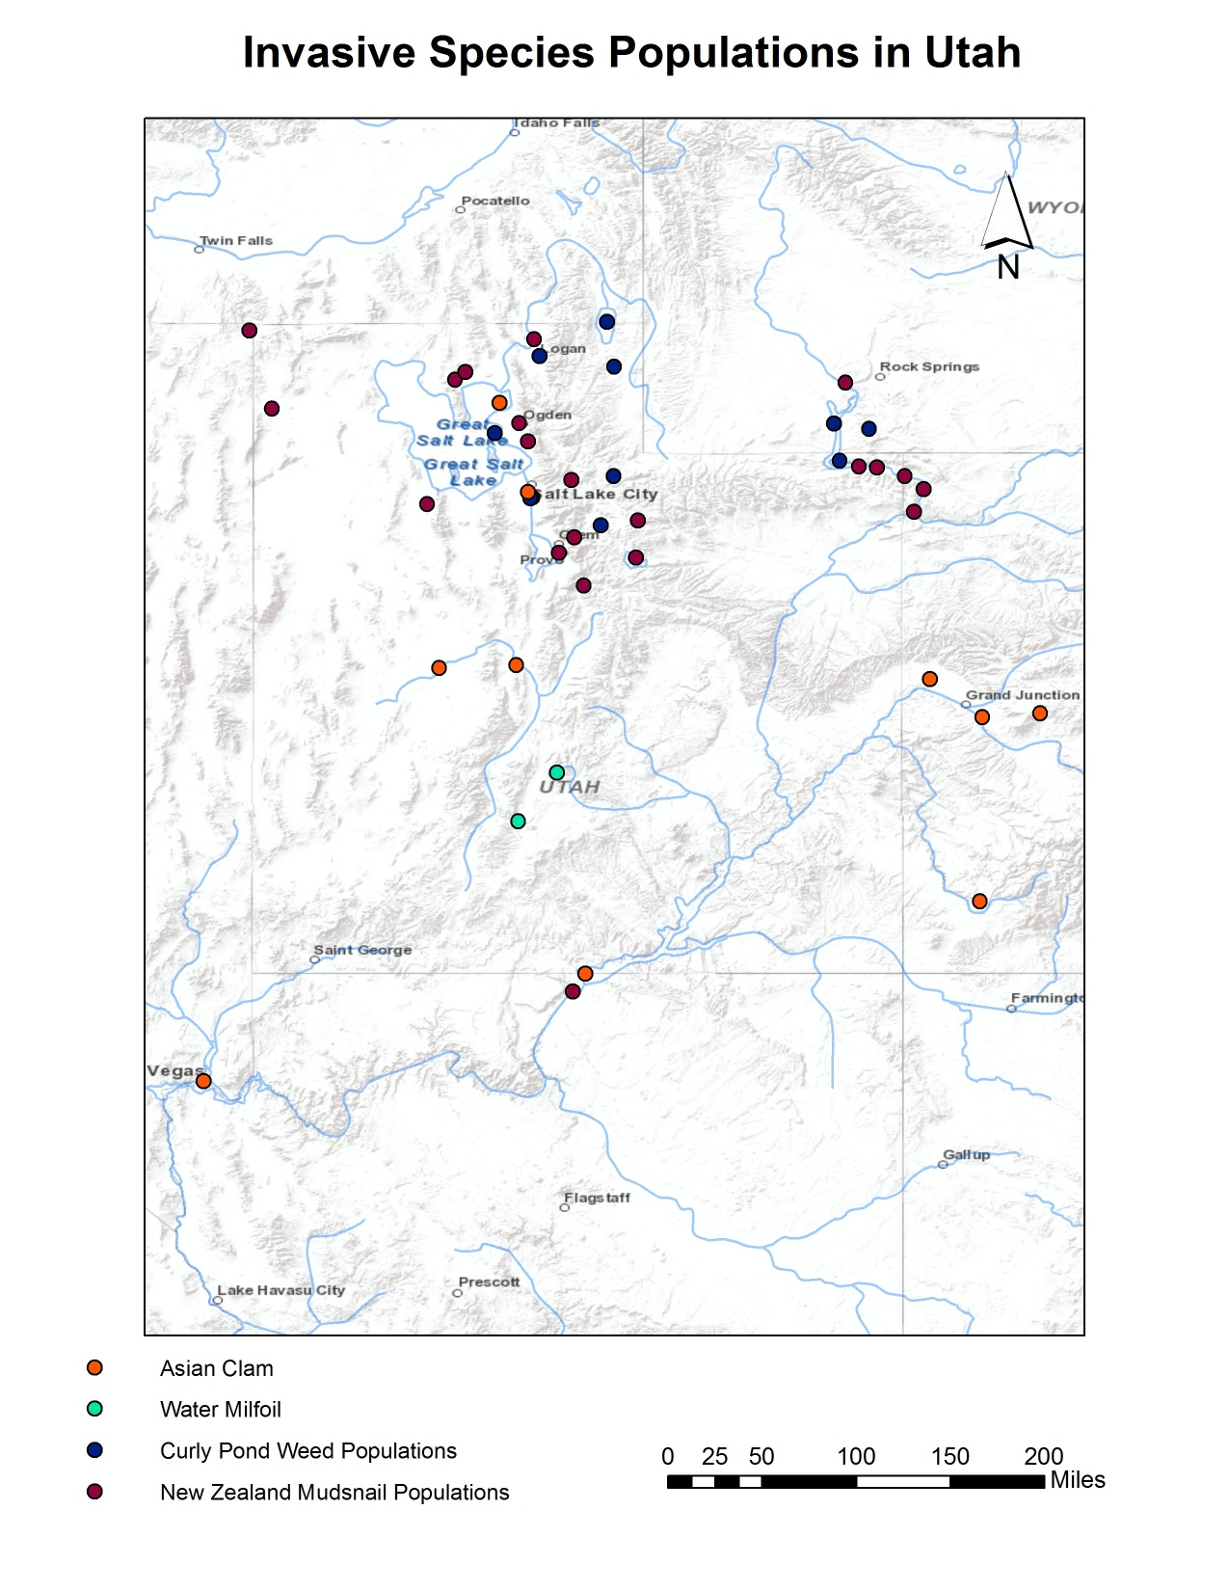
Data derived from: http://www.invasivespeciesinfo.gov/aquatics/main.shtml

Slide 13
References
http://www.oar.noaa.gov/oceans/t_invasivespecies.html
http://www.invasivespeciesinfo.gov/aquatics/main.shtml
Benson, A. J. 2011. Round goby sightings distribution. Retrieved 4/26/2012 from http://nas.er.usgs.gov/taxgroup/fish/roundgobydistribution.aspx.
Benson, A. J. 2011. Zebra Mussel Distribution. Retrieved 4/26/2012 from http://nas2.er.usgs.gov/viewer/omap.aspx?SpeciesID=95
Benson, A. J. 2011. Bighead Carp Distribution. Retrieved 4/26/2012 from http://nas2.er.usgs.gov/viewer/omap.aspx?SpeciesID=514

